Slide 1
Artificial Intelligence
Lecture #32
Artificial Intelligence, Lecturer #16

Slide 2
Contents
Genetic Algorithms
Keywords Related to GA
Basic Steps of Genetic Algorithm
Example Problem & Solution By Genetic Algorithm
Artificial Intelligence, Lecturer #16

Slide 3
Genetic Algorithms
A type of evolutionary computation inspired by Darwin’s theory of evolution.
A genetic algorithm generates a population of possible solutions encoded as chromosomes, evaluates their fitness, and create a new population by applying genetic operators-crossover and mutation.
By repeating this process over many generations, the genetic algorithm breeds an optimal solution to the problem.
Artificial Intelligence, Lecturer #16

Slide 4
Key-Words Related to GA
Gene:A basic unit of chromosome that controls the development of a particular feature of a living organism. In Holland’s (Founder of GA) Chromosome a gene is represented by either 0 or 1.
Chromosomes: A string of genes that represent an individual. Each chromosome consists of a number of gene.
Fitness: The ability of a living organism to survive and reproduce in a specific environment.
Crossover: A reproduction operator that creates a new chromosome by exchanging parts of two existing chromosome.
Mutation: A genetic operator that randomly change the gene value in a chromosome.
Artificial Intelligence, Lecturer #16

Slide 5
Keywords Related to GA (cont.)
Fitness Function: A mathematical function used for calculating the fitness of a chromosome.
Crossover Probability: A number between zero and one that indicates the probability of two chromosomes crossing over.
Mutation Probability: A number between zero and one that indicates the probability of mutation occurring in a single gene.
Offspring: An individual that was produced through reproduction. It also referred to as child.
Population: A group of individuals that breed together.
Artificial Intelligence, Lecturer #16

Slide 6
Basic Steps of Genetic Algorithm
Start
Select a pair of chromosomes for mating
With the crossover probability p_{c} exchange
part of the two selected chromosomes and
select two offspring
Generate a population of
chromosomes of size N:
x₁, x₂, ……, x_{N}
With the mutation probability p_{m} randomly
change the gene Values in the two offspring
chromosomes
Calculate the fitness of
each chromosome:
f(x₁), f(x₂), ……, f(x_{N})
Place the resulting chromosomes
in the new population
No
Termination?
No
Size of Population
equal to N?
Yes
Yes
Stop
Replace the current chromosome population
with the new population
Artificial Intelligence, Lecturer #16

Slide 7
Example Problem & Solution
Find the maximum value of the function (15x-x²), where parameter x varies between 0 and 15.
  Chromosome can be built with only four gene (0-15)
Solution:
Suppose,
  The size of the chromosome population N is 6.
  The crossover probability pc=0.7
  The mutation probability=0.001
  The fitness function=f(x)=15x-x²
Artificial Intelligence, Lecturer #16

Slide 8
Example Problem & Solution
Step 1: GA creates an initial population of chromosomes by filling six 4-bit string with randomly generated ones and zeros
Chromosome Label | Chromosome String | Decoded Integer | Chromosome Fitness | Fitness Ratio
X1 | 1100 | 12 | 36 | 16.51
X2 | 0100 | 4 | 44 | 20.18
X3 | 0001 | 1 | 14 | 6.42
X4 | 1110 | 14 | 14 | 6.422
X5 | 0111 | 7 | 56 | 25.68
X6 | 1001 | 9 | 54 | 24.77
Artificial Intelligence, Lecturer #16

Slide 9
Example Problem & Solution
Step 2: Calculate the fitness of each individual Chromosome
Chromosome Label | Chromosome String | Decoded Integer | Chromosome Fitness | Fitness Ratio
X1 | 1100 | 12 | 36 | 16.51
X2 | 0100 | 4 | 44 | 20.18
X3 | 0001 | 1 | 14 | 6.42
X4 | 1110 | 14 | 14 | 6.422
X5 | 0111 | 7 | 56 | 25.68
X6 | 1001 | 9 | 54 | 24.77
Artificial Intelligence, Lecturer #16

Slide 10
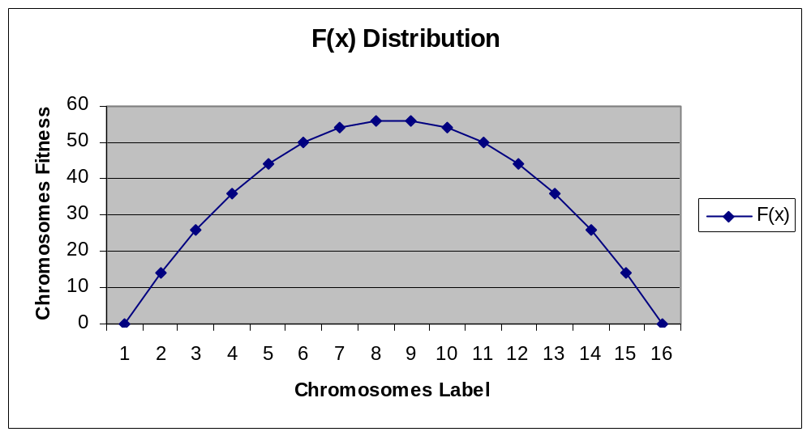
Fitness Function and Chromosome Locations
.
.
.
.
.
.
Artificial Intelligence, Lecturer #16

Slide 11
Example Problem & Solution
Step 3:The fitness ratio determines the chromosome’s chance of being selected for mating.
X5 & X6 have fair chance; X3 & X4 have less chance.
Chromosome Label | Chromosome String | Decoded Integer | Chromosome Fitness | Fitness Ratio
X1 | 1100 | 12 | 36 | 16.51
X2 | 0100 | 4 | 44 | 20.18
X3 | 0001 | 1 | 14 | 6.42
X4 | 1110 | 14 | 14 | 6.42
X5 | 0111 | 7 | 56 | 25.68
X6 | 1001 | 9 | 54 | 24.77
Artificial Intelligence, Lecturer #16

Slide 12
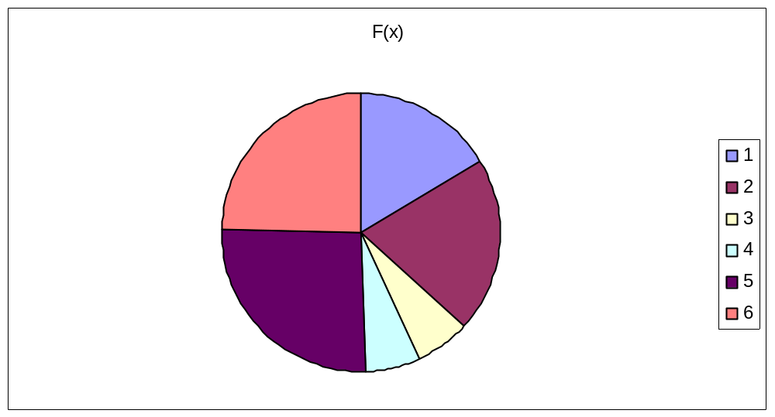
Fitness Function in Roulette Wheel Distribution
1100 (12)=36
0100 (4)=44
0001 (1)=14
1110 (14)=14
0111 (7)=56
1001 (9)=54
Artificial Intelligence, Lecturer #16

Slide 13
Example Problem & Solution
(Mating)
Step 4: Selected chromosome for mating.
First X6 & X2 become parents, 2nd X1 & X5, then X2 & X5.
Generation i |  | Crossover | Mutation
Chromosome Label | Chromosome String
X1_{i} | 1100 |  | X6`_{i} 1000
X2_{i} | 0100 |  | X2`_{i} 0101
X3_{i} | 0001 |  | X1`_{i} 1111, X1``_{i} 1011
X4_{i} | 1110 |  | X5`_{i} 0100
X5_{i} | 0111 |  | X2`_{i} 0100, X2``_{i} 0110
X6_{i} | 1001 |  | X5`_{i} 0111
X6_{i} 10-01
X2_{i} 01-00
X1_{i} 11-00
X5_{i} 01-11
X2_{i} 01-00
X5_{i} 01-11
Artificial Intelligence, Lecturer #16

Slide 14
Example Problem & Solution
(Crossover)
Step 5: Crossover Operator randomly chooses a crossover point where two parent chromosomes ‘Break’ and then exchange the chromosomes after that point.
Generation i |  | Crossover | Mutation
Chromosome Label | Chromosome String
X1_{i} | 1100 |  | X6`_{i} 1000
X2_{i} | 0100 |  | X2`_{i} 0101
X3_{i} | 0001 |  | X1`_{i} 1111, X1``_{i} 1011
X4_{i} | 1110 |  | X5`_{i} 0100
X5_{i} | 0111 |  | X2`_{i} 0100, X2``_{i} 0110
X6_{i} | 1001 |  | X5`_{i} 0111
X6_{i} 10-01
X2_{i} 01-00
X1_{i} 11-00
X5_{i} 01-11
X2_{i} 01-00
X5_{i} 01-11
Artificial Intelligence, Lecturer #16

Slide 15
Example Problem & Solution
(Crossover)
Step 5: If a pair of chromosomes does not cross over then chromosome cloning take places and the offspring are exact copies of each parent.
Generation i |  | Crossover | Mutation
Chromosome Label | Chromosome String
X1_{i} | 1100 |  | X6`_{i} 1000
X2_{i} | 0100 |  | X2`_{i} 0101
X3_{i} | 0001 |  | X1`_{i} 1111, X1``_{i} 1011
X4_{i} | 1110 |  | X5`_{i} 0100
X5_{i} | 0111 |  | X2`_{i} 0100, X2``_{i} 0110
X6_{i} | 1001 |  | X5`_{i} 0111
X6_{i} 10-01
X2_{i} 01-00
X1_{i} 11-00
X5_{i} 01-11
X2_{i} 01-00
X5_{i} 01-11
Artificial Intelligence, Lecturer #16

Slide 16
Example Problem & Solution
(Mutation)
Step 6: The mutation operator flips a randomly selected gene in a chromosome.
Generation i |  | Crossover | Mutation
Chromosome Label | Chromosome String
X1_{i} | 1100 |  | X6`_{i} 1000
X2_{i} | 0100 |  | X2`_{i} 0101
X3_{i} | 0001 |  | X1`_{i} 1111, X1``_{i} 1011
X4_{i} | 1110 |  | X5`_{i} 0100
X5_{i} | 0111 |  | X2`_{i} 0100, X2``_{i} 0110
X6_{i} | 1001 |  | X5`_{i} 0111
X6_{i} 10-01
X2_{i} 01-00
X1_{i} 11-00
X5_{i} 01-11
X2_{i} 01-00
X5_{i} 01-11
Artificial Intelligence, Lecturer #16

Slide 17
Example Problem & Solution
Step 7:The fitness ratio determines the chromosome’s chance of being selected for mating.
X5 & X6 have fair chance; X3 & X4 have less chance.
Generation i |  | Generation i+1
Chromosome Label | Chromosome String | Chromosome Label | Chromosome String | Fitness
X1_{i} | 1100 | X1_{i+1} | 1000 | 56
X2_{i} | 0100 | X2_{i+1} | 0101 | 50
X3_{i} | 0001 | X3_{i+1} | 1011 | 44
X4_{i} | 1110 | X4_{i+1} | 0100 | 44
X5_{i} | 0111 | X5_{i+1} | 0110 | 54
X6_{i} | 1001 | X6_{i+1} | 0111 | 56
Artificial Intelligence, Lecturer #16

Slide 18
Fitness Function and Chromosome Locations
.
.
Artificial Intelligence, Lecturer #16

Slide 19
Recommended Textbooks
[Negnevitsky, 2001] M. Negnevitsky “ Artificial Intelligence: A guide to Intelligent Systems”, Pearson Education Limited, England, 2002.
[Russell, 2003] S. Russell and P. Norvig Artificial Intelligence: A Modern Approach Prentice Hall, 2003, Second Edition
[Patterson, 1990] D. W. Patterson, “Introduction to Artificial Intelligence and Expert Systems”, Prentice-Hall Inc., Englewood Cliffs, N.J, USA, 1990.
[Lindsay, 1997] P. H. Lindsay and D. A. Norman, Human Information Processing: An Introduction to Psychology, Academic Press, 1977.
Artificial Intelligence, Lecturer #16

Slide 20
End of Presentation
Question/Suggestions?
Thanks to all !!!
Artificial Intelligence, Lecturer #16

